Slide 1
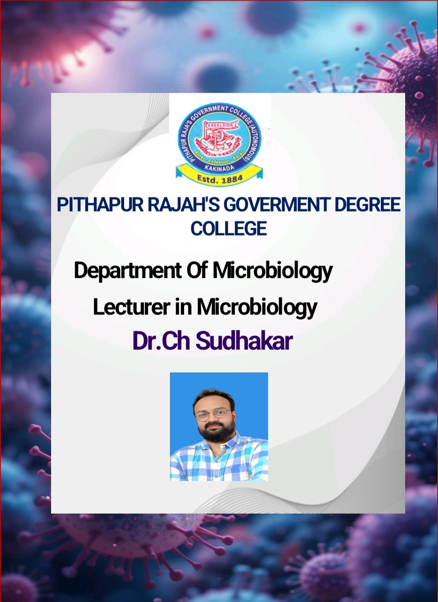

Slide 2

Introduction to Eukaryotic Microorganisms
1. Eukaryotic microorganisms have a true nucleus and membrane-bound organelles.
2. Major groups: Fungi, Algae, Protozoa
3. Found in soil, water, plants, animals
4. Can be unicellular or multicellular
5. Importance: Decomposers, pathogens, producers, indicators

Slide 3
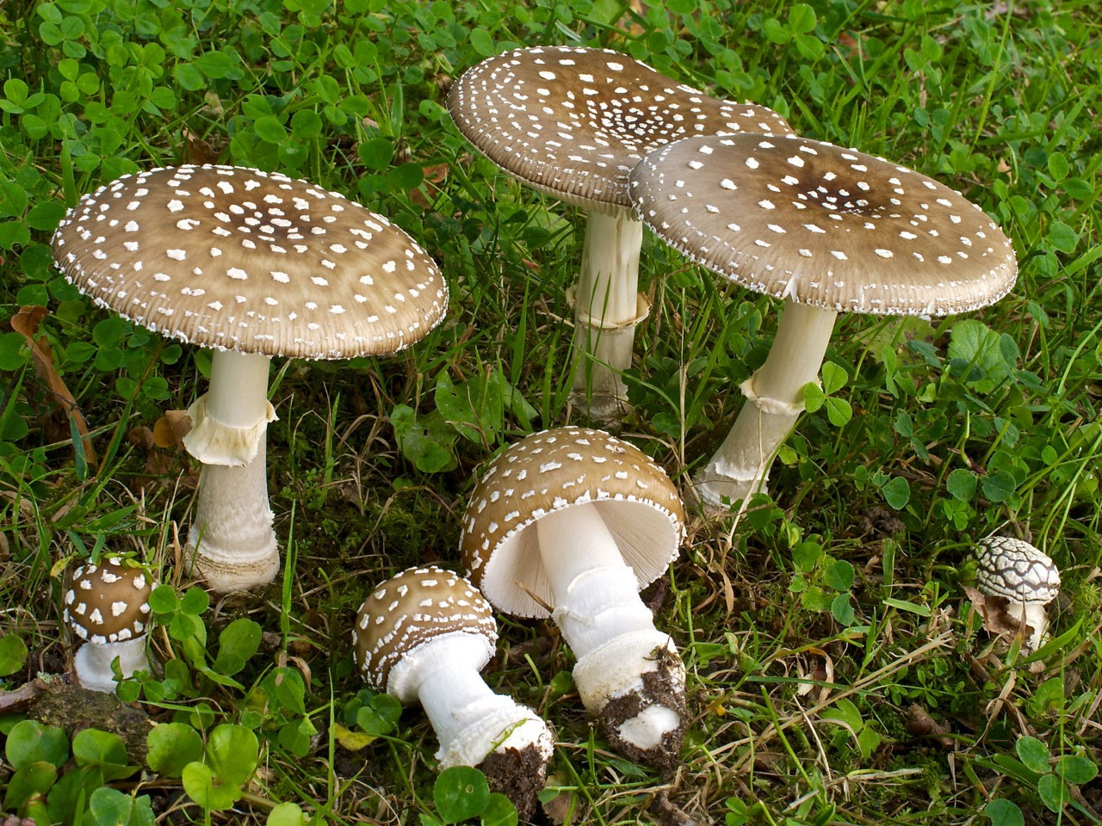
Fungi
1. Habitat: Found in soil, air, decaying matter, on plants and animals
2. Nutrition: Heterotrophic, absorb nutrients (saprophytic, parasitic, mutualistic)
3. Vegetative structure:
a. Made of hyphae (filaments)
b. Hyphae form a network called mycelium
4. Reproduction:
a. Asexual – Spores like sporangiospores, conidia
b. Sexual – Fusion of gametes or hyphae

Slide 4
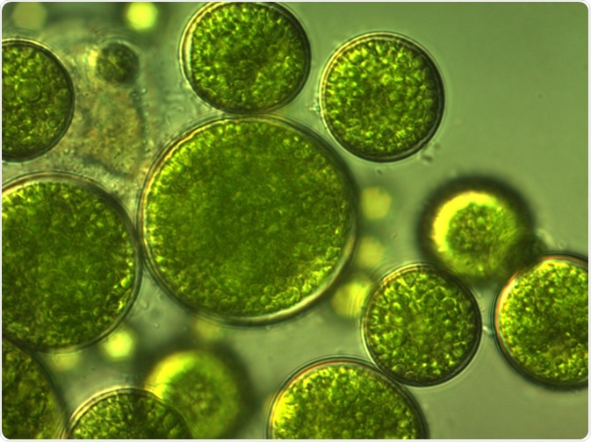
Algae
1. Habitat: Found in freshwater, marine water, moist places
2. Thallus organization:
a. Unicellular (e.g., Chlamydomonas)
b. Multicellular (e.g., Ulva, kelps)
3. Photosynthetic pigments:
a. Chlorophyll a, and others (b, c, d)
b. Carotenoids, phycobilins
4. Storage forms of food:
a. Starch – in green algae
b. Laminarin – in brown algae
c. Floridean starch – in red algae
5. Reproduction:
a. Vegetative – Fragmentation
b. Asexual – Zoospores
c. Sexual – Isogamy, anisogamy,oogamy

Slide 5
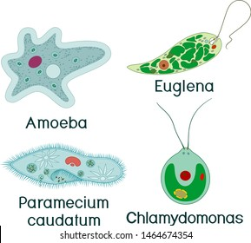
Protozoa
1. Habitat: Mostly aquatic, moist soil, or inside hosts (parasites)
2. Cell structure:
a. Unicellular, with nucleus and organelles
b. Contractile vacuole, pellicle (for shape/support)
3. Nutrition:
a. Holozoic – Ingest solid food
b. Saprophytic – Absorb nutrients
c. Parasitic – From host
4. Locomotion:
a. Pseudopodia – Amoeba
b. Cilia – Paramecium
c. Flagella – Euglena
d. No movement – Plasmodium

Slide 6
Protozoa
1. Excretion:
a. Through contractile vacuole
b. By diffusion
2. Reproduction:
a. Asexual – Binary fission, multiple fission
b. Sexual – Conjugation (e.g., Paramecium)
3. Encystment:
a. Formation of a cyst during harsh conditions
4. Conclusion:
a. Eukaryotic microbes are important in nature, health, and industry
b. Their study helps in medicine, ecology, and biotechnology

Slide 7
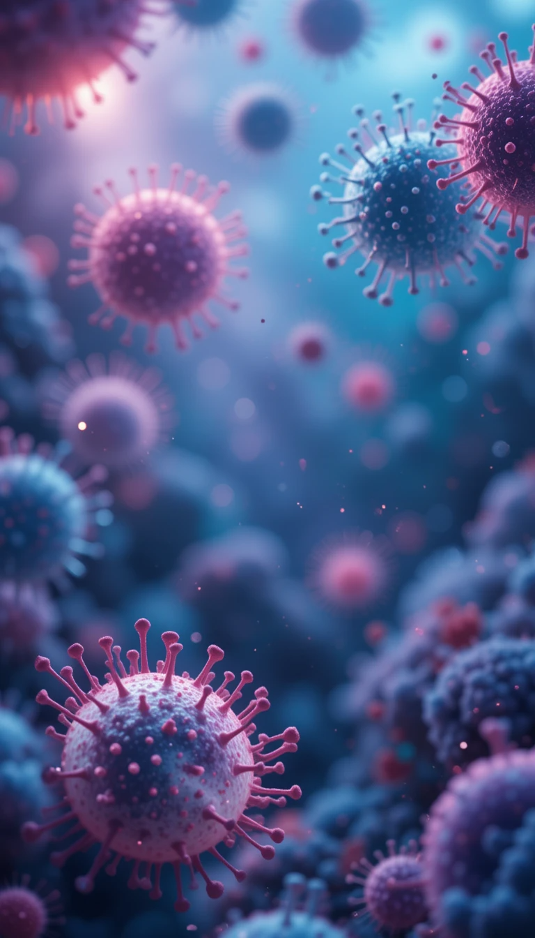

THANK YOU

